Slide 1
GuideGPT
- An on-screen AI Navigator, actually Sees you.
Helping everyone navigate the web – one click at the time.

Slide 2

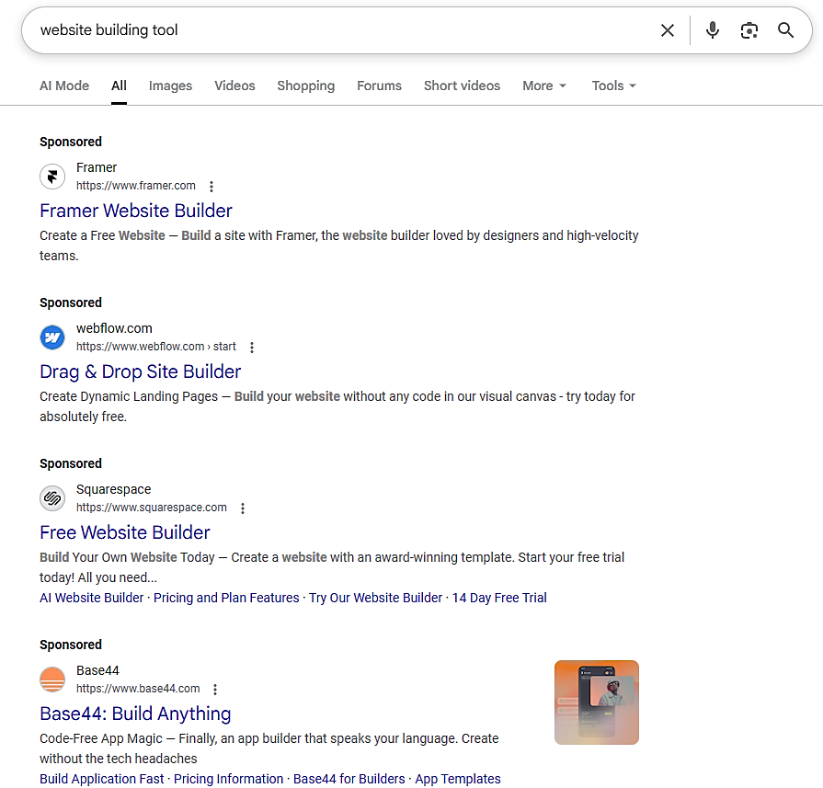
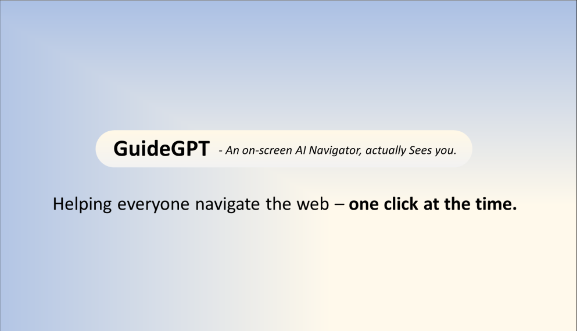






GuideGPT
- An on-screen AI Navigator, actually Sees you.
Helping everyone navigate the web – one click at the time.

Slide 3
GuideGPT -
GuideGPT
- An on-screen AI Navigator, actually Sees you.
Your On-screen AI Navigator
Helping everyone navigate the web – one click at the time.
1.Let a user share their screen.
2.Reads visible content using ChatGPT.
3.Give step-by-step, on-screen guidance with floating chat and highlights for key information.
GuideGPT

Slide 4
GuideGPT
GuideGPT -
- An on-screen AI Navigator, actually Sees you.
An on-screen AI Navigator, actually sees you.
Helping everyone navigate the web – one click at the time.
Technical implementation
Screening sharing: navigator.mediaDevices.getDevices.getDisplayMedia()
Floating chat UI: Custom JS widget / React portal
AI reasoning: Open AI GPT -4o /GPT -5 via API
Browser extension wrapper: Manifest V3

